Slide 1
Sentiment Analysis for Restaurant Reviews Sentiment Classification Using Machine Learning and Deep Learning Models Prepared By: Shidur Sharma Durba 3757255

Slide 2
Introduction
In today's digital age, text communication serves as a fundamental means of interaction.
Humans can understand text emotions or sentiment from context.
It can be difficult to assess the sentiment of data on a large scale.
This is where Sentiment Analysis comes in.
Sentiment Analysis is the process of using text analysis methods, natural language processing (NLP) and computational linguistics to be able to extract, identify, and quantify the sentiment and connotation of any given text accordingly.

Slide 3
Problem
Solution
Assume a business wants to assess the emotional context of more than thousands of reviews of a product.
It can be difficult to manually assess this data due to the sheer volume of data.
We can use Sentiment Analysis with the use of a to automatically detect the sentiment behind large-scale databases of text.

Slide 4
Methodology
Data Collection: 1,000 restaurant reviews with sentiment labels.
Preprocessing: Tokenization, stemming, and vectorization.
Model Training: Naïve Bayes (baseline) and LSTM (deep learning).
Evaluation: Metrics like accuracy, precision, and recall.

Slide 5
Data Collection & Pre-Processing
The dataset consists of 1,000 restaurant reviews, labeled as positive or negative.
RegEx filters were applied to clean the text by removing non-alphabetic characters, ensuring only meaningful words remained.
Stopwords, except for "not," were excluded, and stemming was performed using the Porter Stemmer to reduce words to their root forms (e.g., "loved" to "love").
Tokenization split reviews into individual words for further processing.
The vocabulary size, or the number of unique words, was recorded to provide insights into the dataset’s diversity.

Slide 6
Model Description
Models Used in This Project
Naïve Bayes (NB):
Utilizes the Bag-of-Words (BoW) model to convert text into numerical vectors based on word frequencies
Relies on probabilistic principles, assuming word independence for classification.
Known for simplicity, computational efficiency, and serving as a strong baseline model for text classification tasks.
LSTM (Long Short-Term Memory):
Integrates an embedding layer to create dense vector representations of words, capturing semantic relationships.
Uses recurrent connections to process sequences, making it suitable for understanding context and dependencies.
Effective at handling complex patterns in text, such as negations and sequential sentiment flow.

Slide 7
Model Training and Evaluation
Naïve Bayes was trained using a Bag-of-Words representation, relying on word frequencies without requiring hyperparameter tuning
The LSTM model was trained over 20 epochs with a batch size of 32, using 20% of the training data as validation.
Optimization was performed using the Adam optimizer with a binary cross-entropy loss function to handle binary classification.

Slide 8
Model Evaluation
Metrics Evaluated: Accuracy, precision, recall, and F1-score for both models.
Results Comparison: LSTM outperformed Naïve Bayes, especially in precision and recall for positive sentiments.
Metric | Naïve Bayes | LSTM
Precision (Negative) | 82% | 76%
Precision (Positive) | 68% | 74%
Recall (Negative) | 57% | 71%
Recall (Positive) | 88% | 79%
F1-Score (Negative) | 67% | 73%
F1-Score (Positive) | 77% | 76%
Accuracy | 73% | 75%

Slide 9
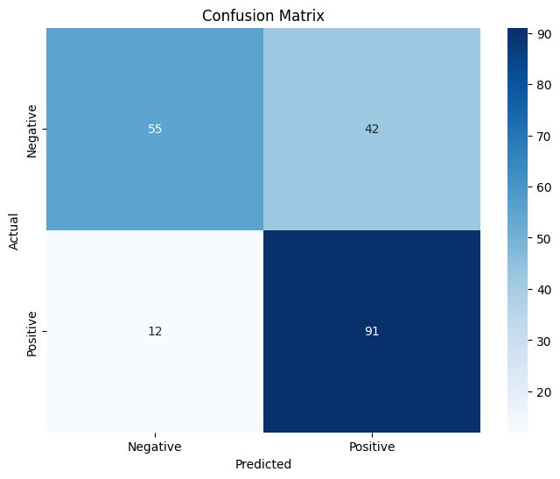
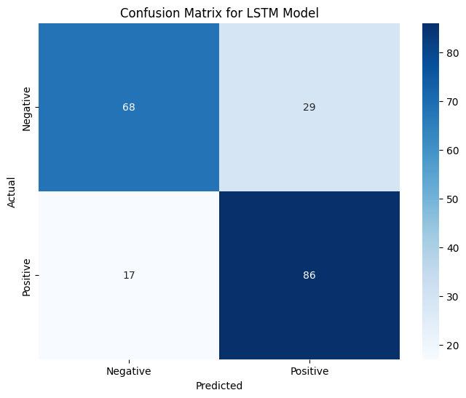
Results
Performance Metrics
Naïve Bayes: 73% accuracy.
LSTM: 75% accuracy.

Slide 10
Discussion and Limitations
Discussion
Naïve Bayes provided a strong baseline with computational efficiency and simplicity.
LSTM demonstrated superior performance by capturing sequential dependencies and semantic nuances.
Results showed real-world applicability, offering insights for customer feedback analysis.
Limitations
Limited to 1,000 reviews, reducing generalizability.
The focus on only positive and negative sentiments excludes neutral or nuanced emotions.
The models were tailored to restaurant reviews, reducing adaptability to other domains without retraining.

Slide 11
Future Work
Expand dataset to include multilingual and diverse reviews.
Transition to multi-class sentiment analysis (neutral, anger, joy).
Leverage transformer-based models like BERT.

Slide 12
Conclusion
LSTM Outperformed Naïve Bayes achieved higher accuracy and better contextual understanding for sentiment analysis.
Automates review analysis, improving customer satisfaction and business strategies.
Positive reviews highlight strengths; negative reviews pinpoint areas to improve.
Models are adapted to the unique patterns of restaurant reviews.
Multi-class sentiment analysis and transformer models could enhance performance further.

Slide 13
Thank you

